Slide 1
An Automated Risk Mitigation in Healthcare Software Delivery using CI&CD Pipelines
Presented By
J. Salai Sanmargam-810022104072
S. Sathish – 810022104075
Guided By
Dr. P. Karthikeyan
Assistant Professor
Department of CSE

Slide 2
ABSTRACT
Hospital Management Systems (HMS) require high availability, strong data security, and reliable software updates. Traditional manual deployment methods are slow and error-prone, making them unsuitable for healthcare applications. This project presents a secure, automated CI/CD pipeline for an HMS, addressing risks across input, runtime, and output stages. The pipeline integrates tools such as Gitleaks for secret scanning, Pytest for backend testing, TypeScript and Vite for frontend validation, Trivy for container security, and GitHub Container Registry with Vercel deployment. Each stage acts as a quality gate, preventing insecure code from reaching production. The HMS is built as a three-tier system using React, FastAPI, and PostgreSQL, supporting multiple roles and healthcare modules. The pipeline executes within minutes, ensuring fast, secure, and reliable deployments. This work demonstrates how DevSecOps practices can enhance software quality, reliability, and patient safety in healthcare systems.

Slide 3
INTRODUCTION
Hospital Management Systems (HMS) require continuous operation, secure handling of patient data, and reliable updates. Traditional manual deployment methods are slow and prone to errors, making them unsuitable for healthcare environments. CI/CD pipelines automate integration, testing, and deployment, improving speed and consistency. However, insecure pipelines can introduce risks such as deploying vulnerable code. This project proposes a secure, automated CI/CD pipeline with testing, containerization, and vulnerability scanning. Using an HMS case study, it demonstrates improved reliability, reduced errors, and enhanced security. Overall, the approach ensures safe, fast, and stable software delivery for healthcare systems.

Slide 4
PROBLEM STATEMENT
Modern hospital software systems require continuous updates, high availability, and strong security. While CI/CD pipelines are used to automate development and deployment, many implementations lack complete validation and security checks. Critical steps like security scanning and artifact verification are often skipped or done manually, increasing risks. This can allow unstable or vulnerable software to reach production systems. The output stage (AS3) is especially critical, where unverified artifacts may introduce security threats. Such issues can lead to data breaches, system failures, and disruption of healthcare services. Therefore, a secure, fully automated CI/CD pipeline with mandatory validation at every stage is essential for hospital systems.

Slide 5
Literature Survey
Year | Author(s) | Key Findings | Advantages | Limitations
2024 | Pan et al. | Identified three CI/CD attack surfaces (AS1, AS2, AS3); 97.86% repos use outdated scripts; 11.04 months update lag | Large-scale empirical study (320k repos); clearly defines CI/CD attack model | Focuses on vulnerability identification; does not provide lightweight practical implementation
2025 | Ashtagi et al. | DevSecOps framework integrating OWASP & Trivy; reduced vulnerabilities by 70% | Demonstrates effective automated security integration; cloud-native architecture | Requires complex infrastructure (Kubernetes, Terraform); enterprise-level setup
2017 | Shahin et al. | Systematic review of CI/CD practices; automation improves quality & reduces time-to-market | Comprehensive academic foundation; tool classification | Older study; limited focus on modern container security
2022 | Mowad et al. | CI/CD reduces Dev-Ops gap; improves lifecycle ownership | Shows operational efficiency & reduced integration issues | Less focus on security enforcement and artifact validation
2024 | Faqih et al. | GitHub Actions workflows emphasize build & test automation | Industry-aligned empirical data; supports GitHub-based pipelines | Focuses on usage trends; limited security-depth analysis
2025 | Gusmedi et al. | DevOps with auto-scaling & load balancing improves hospital system reliability | Healthcare-specific case study; reliability enhancement | Focus more on infrastructure scaling than CI/CD security
2025 | Mohammed et al. | Shift-Left security essential in DevSecOps; integrate security early | Strong academic support for automated security gates | Conceptual review; lacks beginner-level implementation case
2025 | Williams et al. | Compared 9 GitHub security scanners; identified workflow misconfigurations | Practical scanner comparison; supply chain protection focus | Detection varies; no single tool covers all issues

Slide 6
Objectives of the Project
The main objective of this project is to design a secure and automated CI/CD pipeline for hospital software systems to ensure reliable and safe deployments. It aims to automate key stages such as code integration, testing, containerization, and deployment. Docker is used to maintain consistency across environments. The project integrates vulnerability scanning to detect and block insecure components. A security gate at the output stage (AS3) prevents deployment of unsafe artifacts. It also includes monitoring and logging for better control and tracking. The approach is validated using a real Hospital Management System case study.

Slide 7
To automate the key stages of the software development life cycle including code integration, automated testing, containerization, and deployment, eliminating manual intervention.
To use Docker containerization so that the hospital application runs identically across development, testing, and production environments.
To integrate automated vulnerability scanning into the pipeline so that insecure dependencies and container images are detected and blocked before deployment.
To establish a security gate at the output stage (AS3) that prevents deployment whenever critical vulnerabilities are present.
To validate the design end-to-end through a real Hospital Management System case study covering seven user roles and twelve operational modules.

Slide 8
EXISTING SYSTEM
In traditional hospital software systems, deployment is mostly manual or only partially automated. Developers test updates locally and deploy them manually, which is time-consuming and error-prone. Basic CI/CD pipelines, where used, focus mainly on build and simple testing. Critical steps like security validation, artifact verification, and controlled deployment are often missing. This leads to heavy reliance on human intervention and inconsistent processes. Urgent situations may cause teams to skip tests and release unstable software. As a result, system reliability and consistency across environments are compromised.

Slide 9
Limitations of Existing System
High dependency on manual intervention. Repeated manual errors during deployment cause application failures, incorrect data processing, and downtime.
Lack of enforced security validation. Vulnerability scanning, dependency checking, and artifact verification are often optional or done after deployment.
Uncontrolled output artifacts (AS3 vulnerability). Final builds and Docker images are trusted without verification, allowing vulnerable or outdated components into production.
Inconsistent deployment environments. Differences in configurations, libraries, and runtimes cause unexpected behavior in clinical settings.

Slide 10
PROPOSED SYSTEM
The proposed system introduces a fully automated and secure CI/CD pipeline for hospital software systems like HMS. It ensures that every code update follows strict validation and security checks before deployment. A centralized repository acts as the single source of truth, triggering the pipeline on each change. The pipeline includes stages such as build, testing, Docker containerization, vulnerability scanning, and controlled deployment. Each stage acts as a mandatory checkpoint, stopping the process if any failure occurs. This prevents insecure or unstable software from reaching production. The system is demonstrated using a Hospital Management System case study.

Slide 11
Advantages of Proposed System
Automation-driven risk reduction. Eliminates manual intervention; every update follows the same workflow, lowering human error.
Enforced output-stage security (AS3 mitigation). Vulnerability scanning ensures only safe Docker images are deployed.
Consistent and reproducible environments. Containerization removes drift between development, testing, and production.
Early detection of issues. Automated testing and scanning catch problems before they reach production.
Suitability for healthcare applications. High reliability, data integrity, and secure deployment match HMS requirements.
Beginner-friendly implementation. Uses GitHub Actions, Docker, and Trivy - free, widely used, and well documented.

Slide 12
5. System Architecture
Layers:
Development Layer – Developer writes code.
Version Control Layer – GitHub repository.
CI/CD Layer – GitHub Actions workflow.
Security Layer – Trivy vulnerability scan.
Artifact Layer – Docker image.
Deployment Layer – Vercel server.

Slide 13
Architecture integrates development, automation, security, and deployment into a unified framework. Developers push updates to a centralized GitHub repository which acts as the single source of truth. Each push triggers the CI/CD automation layer, which performs code checkout, dependency installation, automated testing, build, and validation. A dedicated security layer scans dependencies and Docker images using Trivy. The deployment layer uses Docker containerization to release the application to its target environment, while a monitoring layer tracks pipeline execution and emits alerts. The result is a secure, automated, and reliable workflow for hospital software.

Slide 14
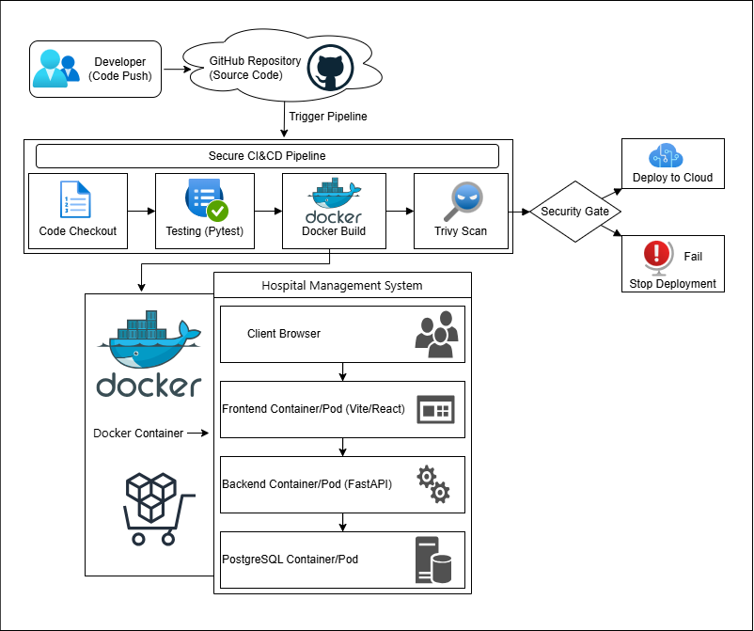
System Architecture

Slide 15
CI/CD Pipeline Architecture
The CI/CD pipeline architecture defines a structured workflow through which code moves from development to deployment. It is a sequence of automated stages, each acting as a quality gate. The pipeline is triggered when a developer pushes code to GitHub. The first stage is code checkout. Pytest then validates correctness. Once testing passes, the pipeline proceeds to the build stage where a Docker image is created. The next stage is vulnerability scanning, which is critical for security: Trivy scans the image for known CVEs, outdated dependencies, and misconfigurations. If critical issues are detected the pipeline stops immediately. If all stages pass, the pipeline proceeds to controlled deployment to the target environment. The architecture provides automated execution, early error detection, security enforcement, and controlled, reliable deployment.

Slide 16
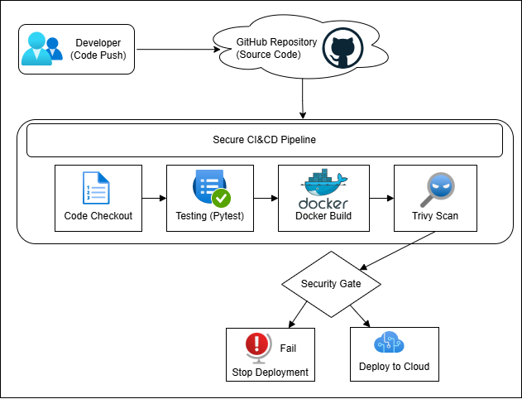
CI/CD Pipeline Flow

Slide 17
Application Architecture (3-Tier HMS)
The Hospital Management System uses a three-tier architecture that separates concerns and improves maintainability.
Tier 1 - the presentation tier is a Single Page Application built with React 19, TypeScript, and Vite. It runs in the user's browser and communicates with the backend through RESTful API calls over HTTPS.
Tier 2 - the application tier is a FastAPI backend on Python 3.11 served by Uvicorn. It contains business logic, authentication and authorization, validation, PDF invoice generation, and the REST API endpoints; it accesses the database through psycopg2's ThreadedConnectionPool.
Tier 3 - the data tier is a PostgreSQL 16 relational database. Locally it runs as the postgres:16-alpine container; in production it uses Neon DB, a serverless PostgreSQL service offering automatic scaling and zero-downtime upgrades. The schema contains 19 interrelated tables covering all hospital domains.

Slide 18
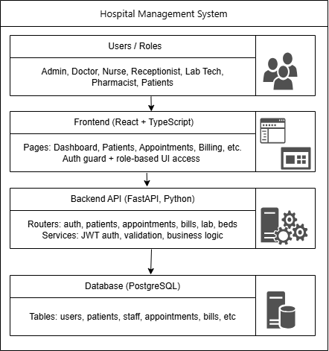
HMS 3-Tier Architecture

Slide 19
TOOLS AND TECHNOLOGIES USED
Git & GitHub – Version control.
GitHub Actions – CI/CD automation.
Docker – Containerization.
Trivy – Vulnerability scanning.
Vercel – Deployment.
Python (Flask) – Backend development.
Neon – Database.

Slide 20
Category | Tool | Purpose
Version Control | Git + GitHub | Source code management
Frontend Framework | React 19 + TypeScript | User interface
Build Tool | Vite 6 | Frontend bundling
Backend Framework | FastAPI | REST API server
Backend Language | Python 3.11 | Server-side logic
Database | PostgreSQL 16 / Neon DB | Data persistence
Containerization | Docker + Docker Compose | Application packaging
CI/CD | GitHub Actions | Automated pipelines
Deployment | Vercel | Cloud hosting
Security Scanning | Gitleaks, Trivy | Vulnerability detection
API Testing | Pytest, curl | Endpoint testing

Slide 21
Installation Instructions
1. Prerequisites (Verify Tools) python --version node --version npm --version psql --version docker --version git --version
2. Clone Repository git clone https://github.com/your-username/Hospital-management-system.git cd Hospital-management-system
3. Environment Setup cp .env.example .env
4. Install Backend cd backend python -m venv .venv .venv\Scripts\activate pip install -r requirements.txt
5. Install Frontend cd frontend npm install

Slide 22
6. Database Setup psql -U postgres CREATE DATABASE medcore_hms; cd backend python init_db.py
7. Run Application cd backend uvicorn app.main:app --reload
cd frontend npm run dev
8. Docker Setup docker-compose up –build
9. CI/CD (Auto via GitHub Actions) (push code to trigger pipeline)
10. Optional Trivy Scan trivy image hospital-management-system-backend:latest trivy image hospital-management-system-frontend:latest
11. Deployment (Local / Docker / Vercel via GitHub Actions)

Slide 23
IMPLEMENTATION PLAN
Phase 1 – HMS Application Development Phase 2 – Dockerization Phase 3 – CI/CD Workflow Creation Phase 4 – Security Integration Phase 5 – Testing & Validation Phase 6 – Deployment

Slide 24
EXECUTION FLOW
When a developer pushes code to the repository, the secret scan workflow runs first. If Gitleaks detects a suspicious pattern the pipeline halts. Once secret scanning passes, ci-backend.yml runs Ruff and Pytest while ci-frontend.yml runs the TypeScript compiler and builds the Vite bundle in parallel. If both succeed, docker-publish.yml builds and pushes images to GHCR. docker scan.yml then scans the published images with Trivy. If any fixable critical vulnerability is found the pipeline stops and reports the finding. Otherwise deploy.yml deploys the new build to Vercel and runs a smoke test against the deployed health endpoint. The entire flow typically completes in five to ten minutes.

Slide 25
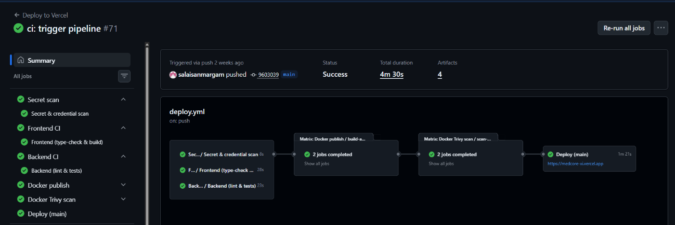
RESULTS AND OUTPUTS
CI/CD Pipeline Run Results

Slide 26
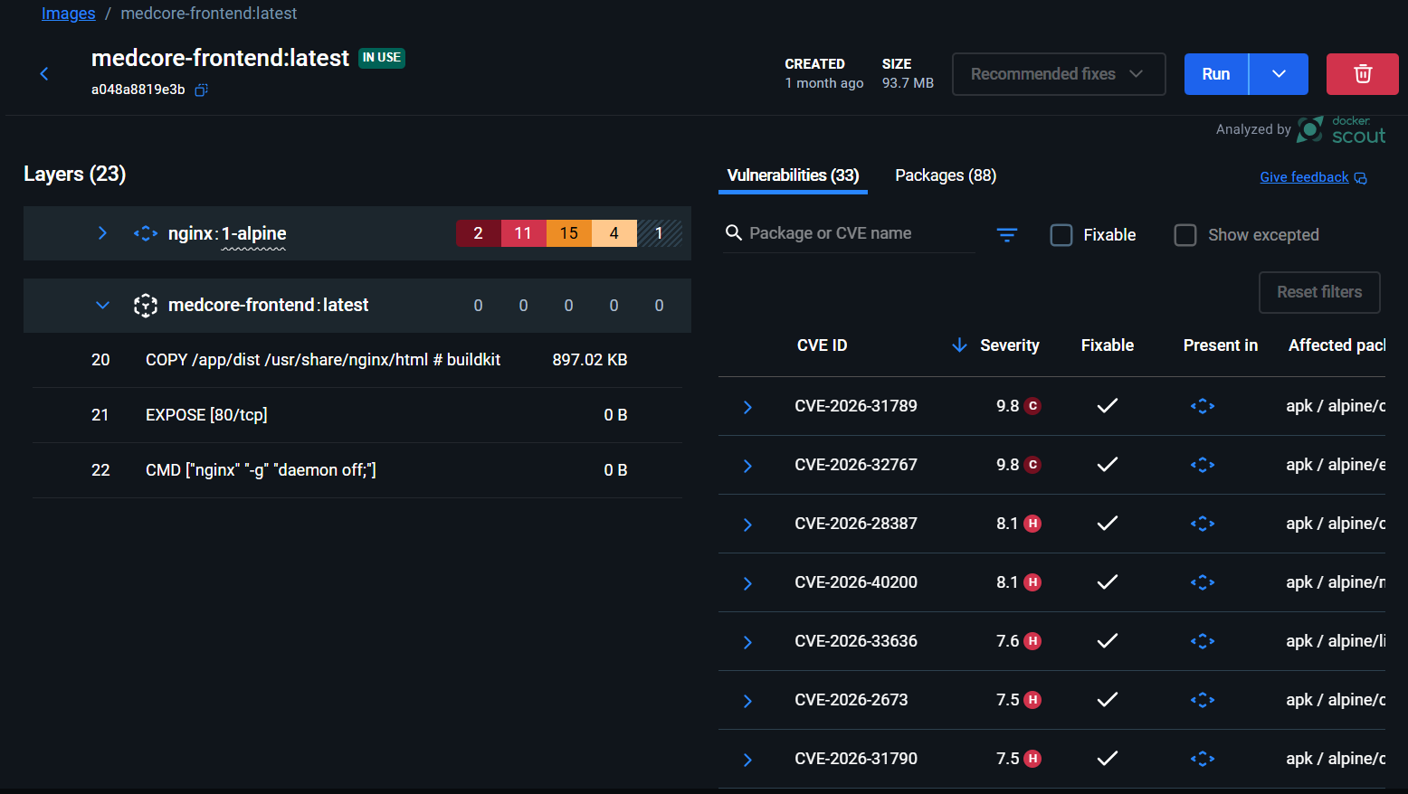
Vulnerability Scan Results

Slide 27
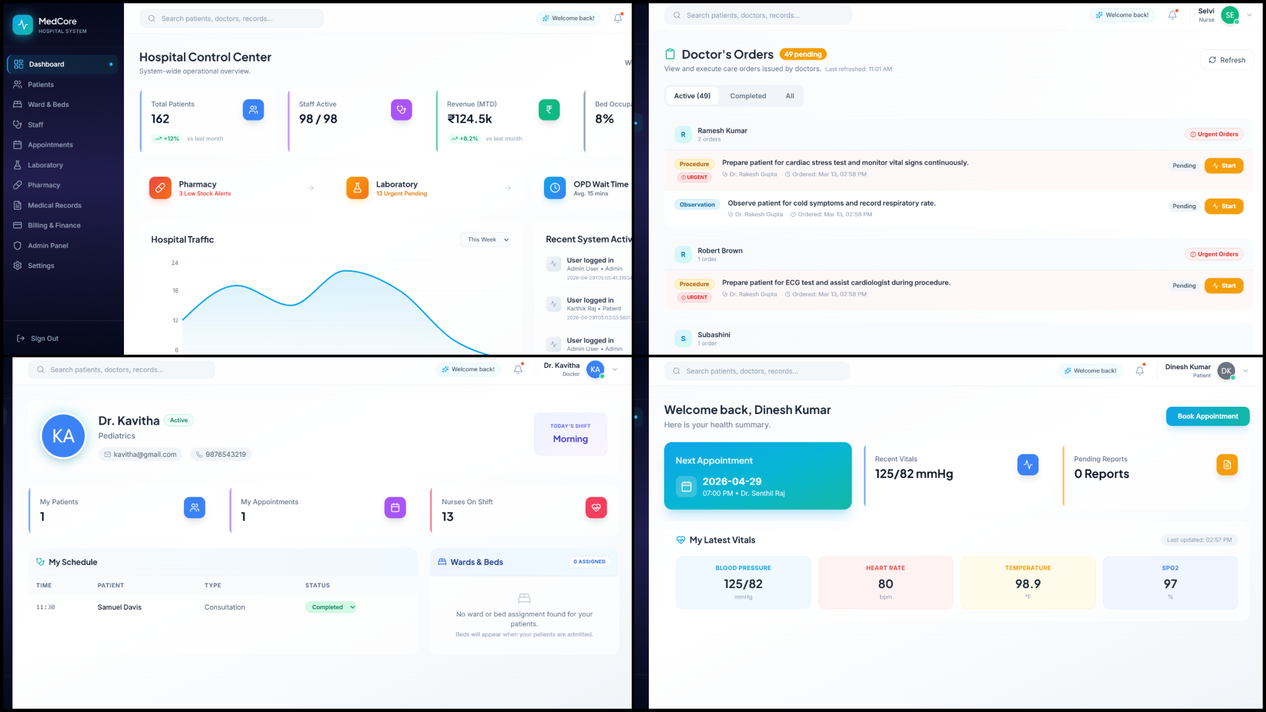
HMS Application Dashboard

Slide 28
CONCLUSION This project developed MedCore HMS with a secure, multi-gate CI/CD pipeline for safe and reliable software delivery. The pipeline enforces strict validation, testing, and vulnerability scanning, preventing insecure deployments. It improved system reliability, reduced manual errors, and ensured consistency across environments. Overall, it demonstrates how DevSecOps practices enhance security and efficiency in healthcare systems.
FUTURE ENHANCEMENTS
Future work includes cloud-native deployment using Kubernetes with autoscaling and zero-downtime updates.
Observability tools like Prometheus and Grafana can be added for monitoring and performance tracking.
Advanced security features such as DAST, SBOM, and fine-grained access control can strengthen protection.
Additional improvements include AI-based features, interoperability standards, and compliance support.

Slide 29
THANK YOU

